Slide 1



learn invent impact
Control Path Model (CPM) for Loop Behaviors
Suresh C. Kothari
Professor, Department of Electrical and Computer Engineering
President & Founder EnSoft Corp.
Acknowledgement: Team members at Iowa State University and EnSoft, DARPA contracts FA8750-12-2-0126 & FA8750-15-2-0080

Slide 2
Why model loop behaviors?
Analyzing loop behaviors (behaviors created by executing loops) is crucial for detecting several cybersecurity vulnerabilities.
Without a good model that abstracts behaviors, it is practically impossible to analyze most loops.
Example: Algorithmic Complexity (AC) vulnerabilities are caused by loops. AC vulnerabilities are exploited to create denial of service (DoS) attacks. DARPA launched the STAC Program inn 2015 to advance loop analysis techniques for analyzing AC vulnerabilities¹. This lecture module is based on the research we did on the STAC Program.
DARPA STAC Program on algorithmic complexity vulnerabilities: https://www.darpa.mil/program/space-time-analysis-for-cybersecurity
Billion Laughs or XML Bomb attack: https://en.wikipedia.org/wiki/Billion_laughs_attack

Slide 3

Watch the XML Bomb Demonstration
https://www.youtube.com/watch?v=WQUiub2hc0c

Slide 4
The explosion of loop behaviors
Iterations = i
Behaviors within one iteration = n
n^{i}
Total # Behaviors =
Suppose there are b non-nested branch conditions inside the loop then n = 2^{b}
Total # Behaviors =
2^{bi}
Total # Behaviors = 2^{5*100} = approx. 10¹⁵⁰
Much larger than the estimated number of atoms in the universe
i = 100 and b = 5

Slide 5
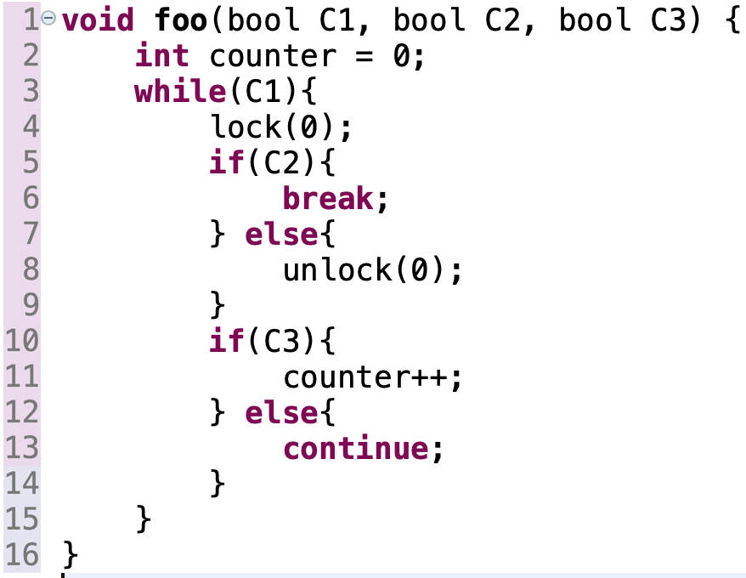
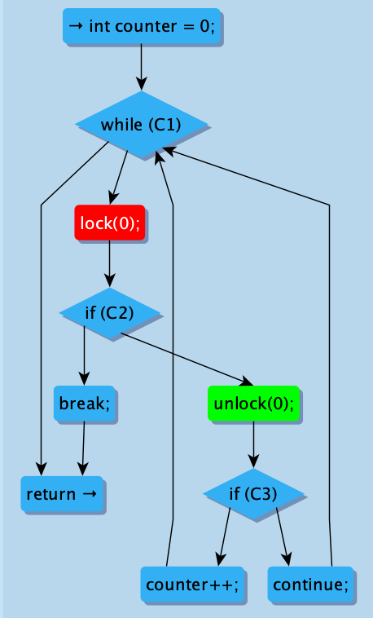
Experiment to get insights for a good loop model
Observations pertinent to loop behaviors?
Two Iterable paths: Lock followed by Unlock on both
Exceptional path: Lock not followed by Unlock
The loop may not be entered – neither Lock nor Unlock
(Lock followed by Unlock is vacuously true)
Lessons for creating a good loop model ?
Answer:
Total number of paths due to the loop = two normal paths + one exceptional path + loop not entered path = 4
Out of 4, one path where Lock not followed by Unlock
How many paths where Lock is not followed by Unlock?
This is a toy replica of a problem we found in Linux
Lessons:
Include two categories of control paths: (a) normal (Iterable) paths from the header to the tail of the loop-back edge, (b) exceptional (non-Iterable) paths from the header to break or return
Include the possibility that loop is not entered
No need to include the number of iterations for a normal path

